Slide 1
DESIGN (ANTI-)PATTERNS
Observer
Jaroslav Sobek
24.4.2019

Slide 2
WHAT ARE DESIGN PATTERNS
A software design pattern is a general, reusable solution to a commonly occurring problem. It is not a finished design that can be transformed directly into source or machine code. It is a description or template for how to solve a problem that can be used in many different situations. Design patterns are formalized best practices that the programmer can use to solve common problems when designing an application or system.
Types
Creational (singleton, builder, lazy init, abstract factory, object pool etc.)
Structural (adapter, bridge, decorator, facade, composite, proxy etc.)
Behavioral (iterator, strategy, template method, visitor, command, observer etc.)
Concurrency (thread pool, double checked locking, monitor object, reactor etc.)

Slide 3
OBSERVER
GoF Definition
The observer pattern is a design pattern that defines a link between objects so that when one object's state changes, all dependent objects are updated automatically. This pattern allows communication between objects in a loosely coupled manner.
Concept
The observer pattern is used to allow a single object, known as the subject, to publish changes to its state.
This is a behavioural pattern as it defines a manner for controlling communication between classes or entities.
The pattern gives loose coupling between the subject and its observers. The subject holds a collection of observers that are set only at run-time.
Each observer may be of any class that inherits from a known base class or implements a common interface. The actual functionality of the observers and their use of the state data need not be known by the subject.

Slide 4
OBSERVER
What problems can the Observer design pattern solve?
A one-to-many dependency between objects should be defined without making the objects tightly coupled.
It should be ensured that when one object changes state an open-ended number of dependent objects are updated automatically.
It should be possible that one object can notify an open-ended number of other objects.

Slide 5
OBSERVER
Additional information
The observer pattern can cause memory leaks, known as the lapsed listener problem, because in basic implementation it requires both explicit registration and explicit deregistration, as in the dispose pattern, because the subject holds strong references to the observers, keeping them alive. This can be prevented by the subject holding weak references to the observers.
While the library classes java.util.Observer and java.util.Observable exist, they have been deprecated in Java 9 because the model implemented was quite limited.

Slide 6
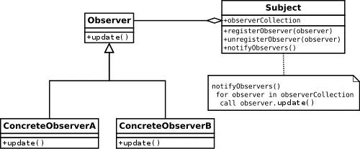
UML class diagram #1

Slide 7
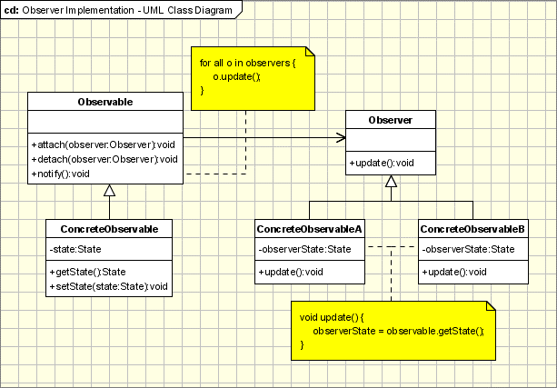
UML class diagram #2
Observable - interface or abstract class defining the operations for attaching and de-attaching observers to the client. In the GOF book this class/interface is known as Subject.
ConcreteObservable - concrete Observable class. It maintain the state of the object and when a change in the state occurs it notifies the attached Observers.
Observer - interface or abstract class defining the operations to be used to notify this object.
ConcreteObserverA, ConcreteObserver2 - concrete Observer implementations.

Slide 8
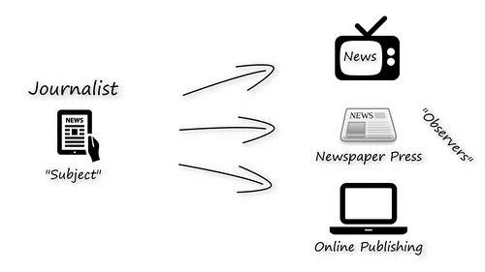
Observer Demo

Slide 9
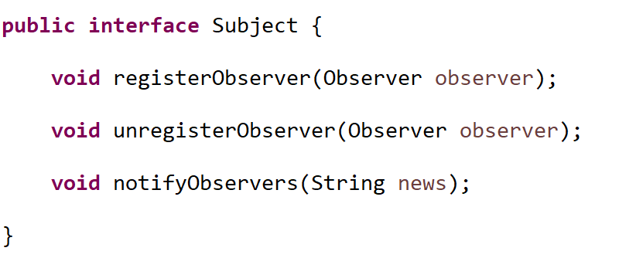
OBSERVER
Subject - interface

Slide 10
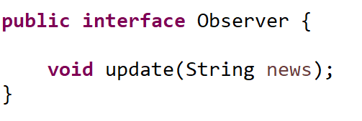
OBSERVER
Observer - interface

Slide 11
OBSERVER
Sources
https://en.wikipedia.org/wiki/Observer_pattern
https://www.baeldung.com/java-observer-pattern
https://www.oodesign.com/observer-pattern.html
https://www.journaldev.com/1739/observer-design-pattern-in-java

